Slide 1
Capstone Project-1
Terrorism Around The Globe
Suraj Pandey

Slide 2
Content
Analysis Based on:
Region
Country
City
Year
Trends:
Characteristic of Terrorist Activity
Terrorist Group Trend
Type of Attack Trend in Region
Terrorism In India:
State Wise
Active Terrorist Groups in India
The Application:
Conclusion:

Slide 3
Problem Statements
Analysis based on global terrorism by year.
Analysis based on terrorist activities.
Analysis based on Indian terrorist group.
An application, which helps us to fetch information about terrorism.

Slide 4
Data Summary
Data set name-- Global Terrorism Database (GTD) including information on terrorist attacks around the world from 1970 to 2017.
Shape--
Rows- 181691
Columns-135
Important Columns-- Year, Month, Day, Country, Region, Attack Type, Target, Killed, Wounded, Summary, Group, Target_type, Weapon_type

Slide 5
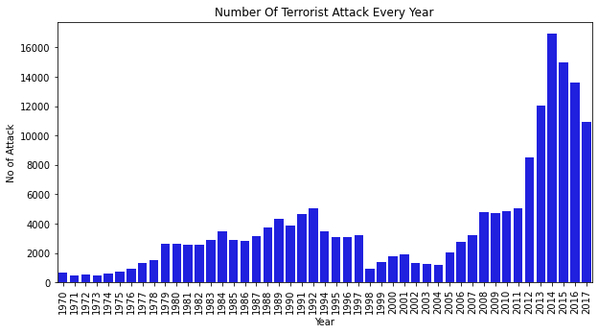
Analysis Based on Year

Slide 6
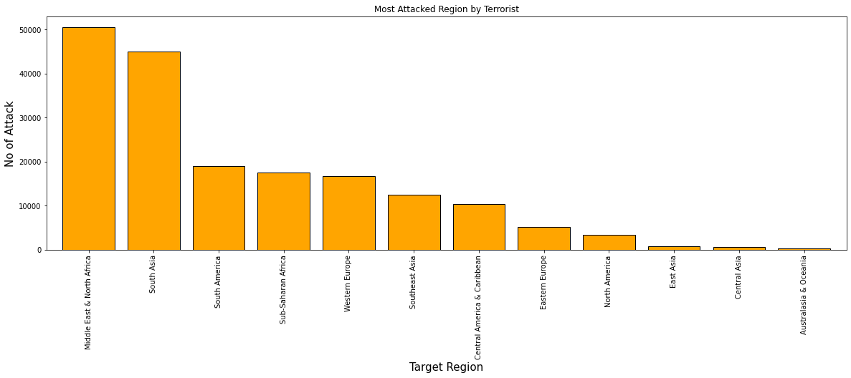
Analysis on Region

Slide 7
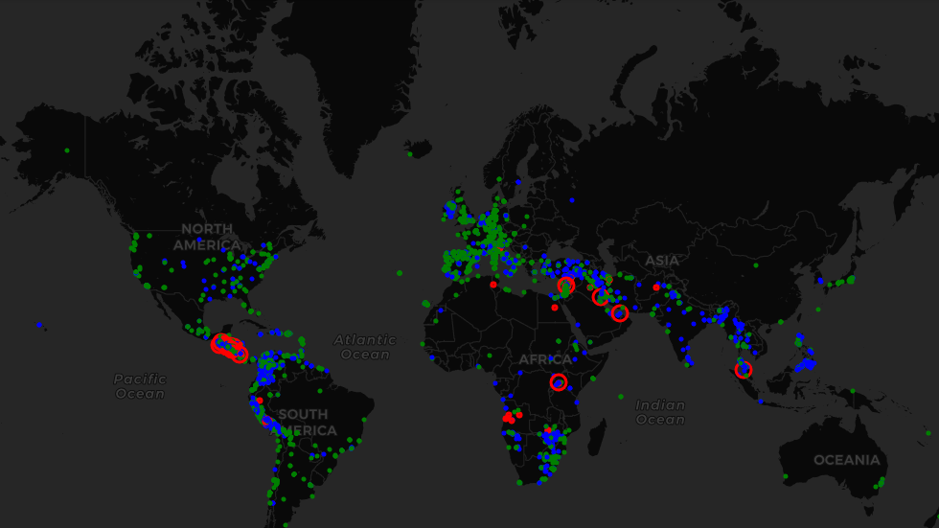
Analysis on Region By World Map

Slide 8
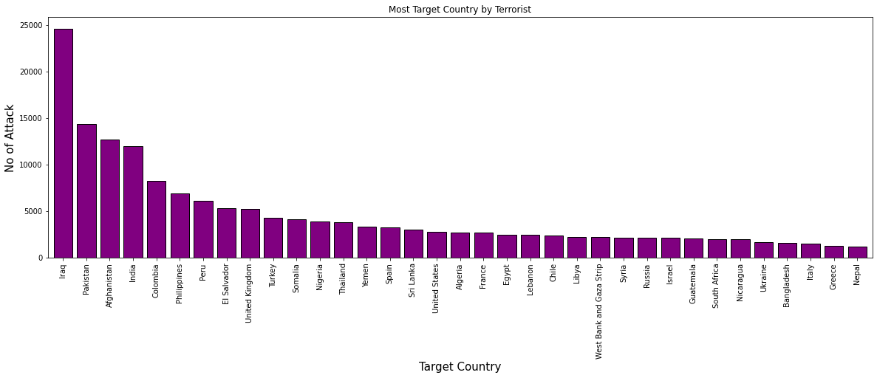
Analysis on Country

Slide 9
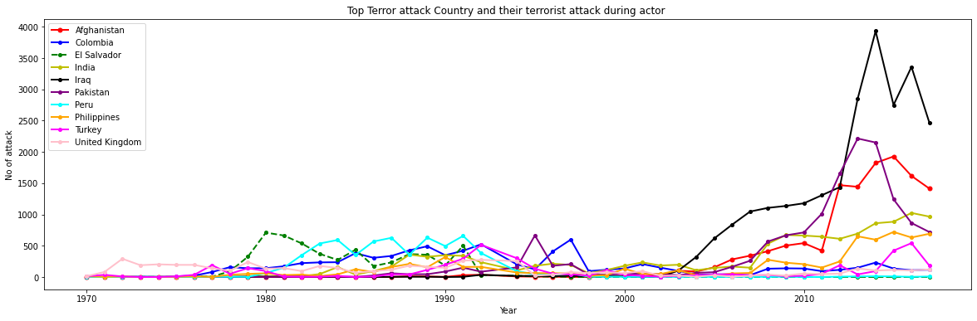
Analysis on Country in Year

Slide 10
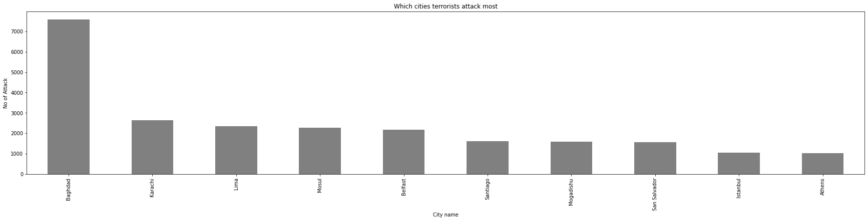
Analysis on City

Slide 11
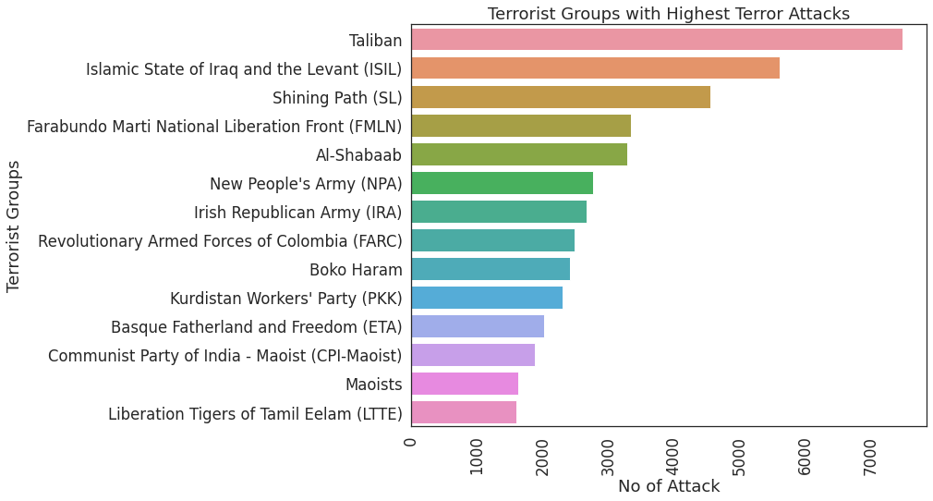
Characteristic of Terrorist Activities

Slide 12
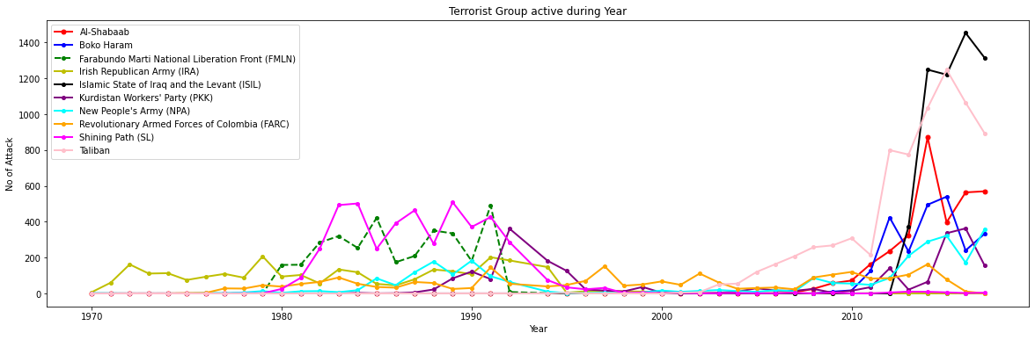
Characteristic of Terrorist Activities (Year)

Slide 13
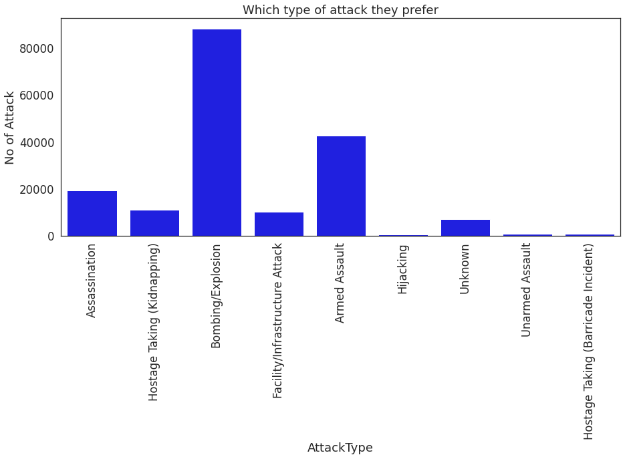
Terrorist Group Trend

Slide 14
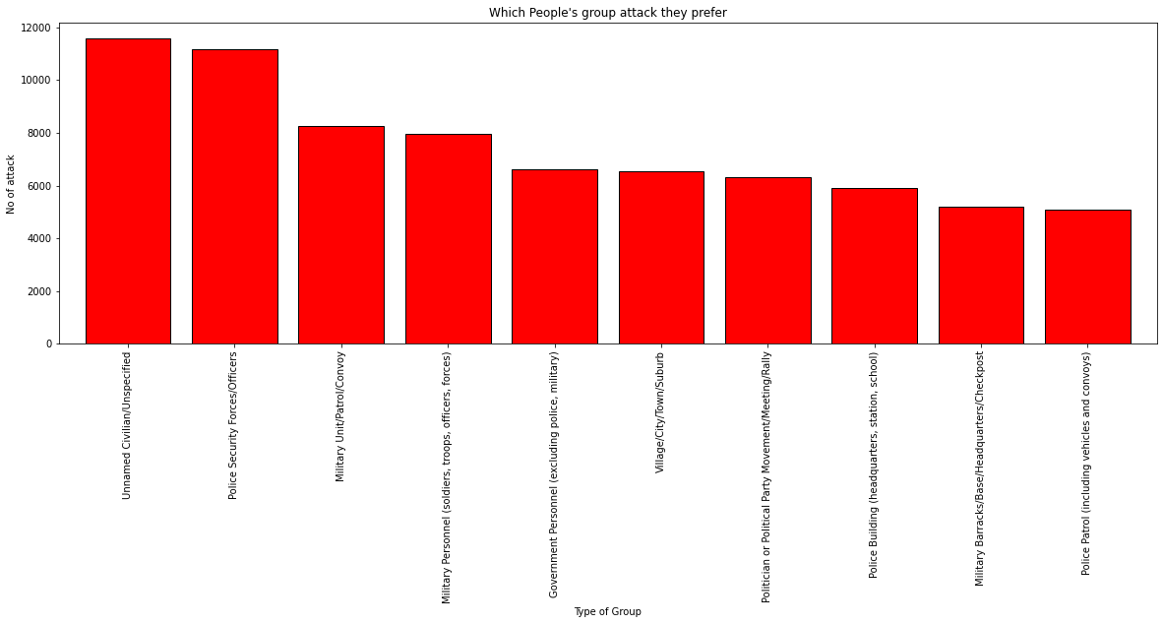
Terrorist Group Trend by Target Type

Slide 15
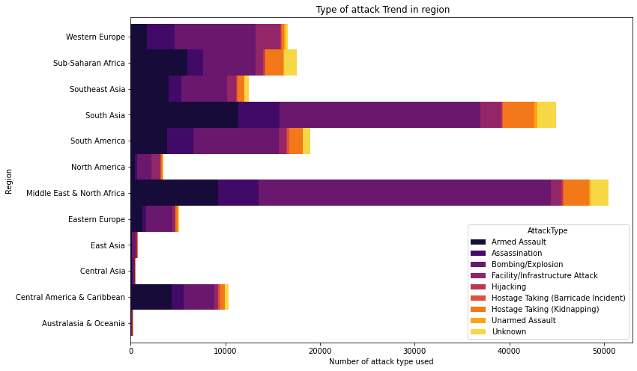
Type of Attack Trend in Region

Slide 16
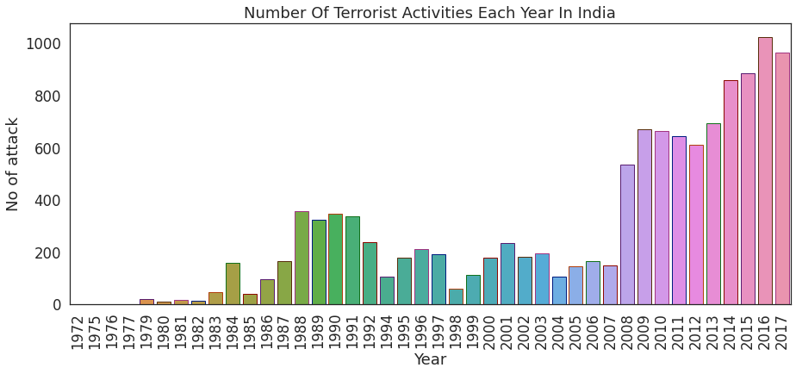
Terrorism In India

Slide 17
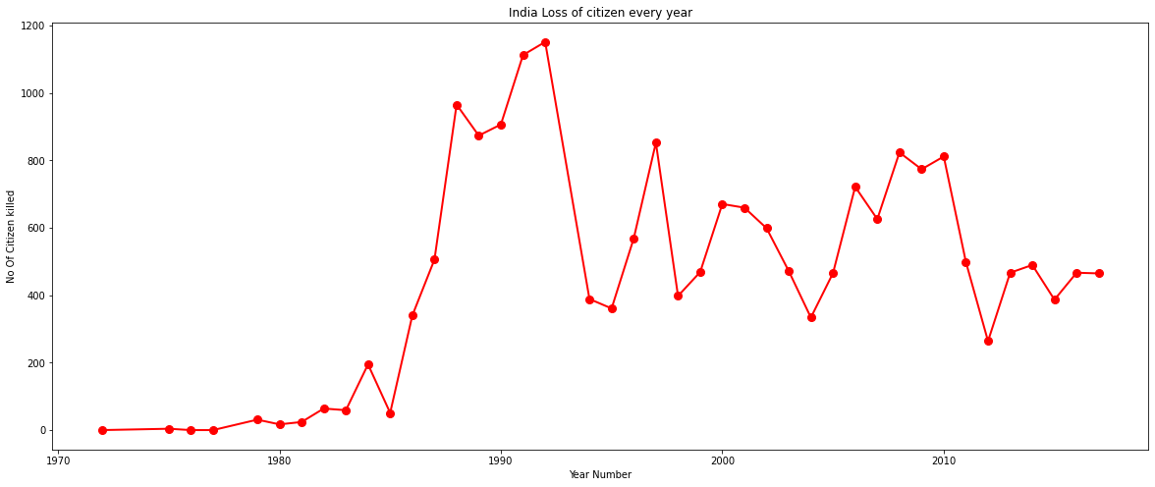
Terrorism In India (Victims)

Slide 18
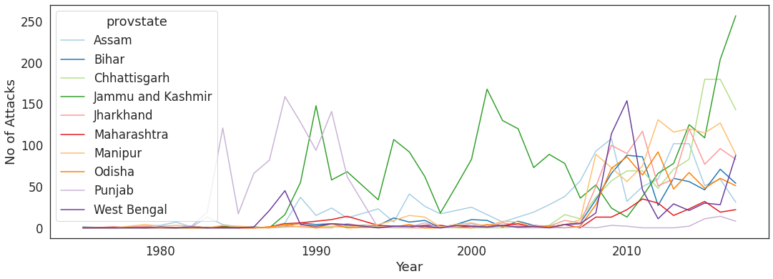
Terrorism In Indian State

Slide 19
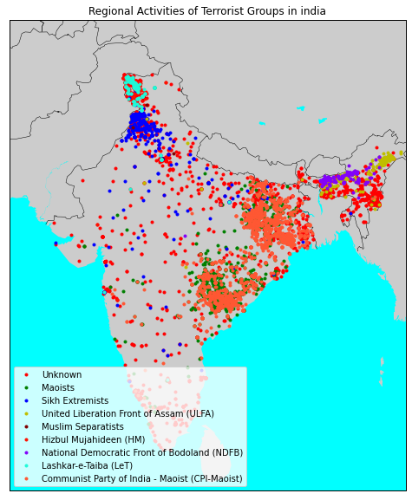
Active Terrorist Groups in India

Slide 20

The application gives us detailed plots for terrorism. And tell us which country safe or not.

Slide 21
Challenges
Difficult to recognize so many columns names like -INT_ISC,INT_LOG etc.
Lots Of NaN values in data set.
Difficult to plot geomap due to lack of location information.
Lots of information is in gibberish form.
Due to large data set it takes time to load.
We faced lots of issues while loading packages for maps.

Slide 22
Conclusion
It is visible that the Middle-East and Southern-Asia are the regions with highest terrorist activities.
Iraq has witnessed a very large number of terrorist activities followed by Pakistan.
It seems like Taliban, ISIL, SL, Al-Shabab, NPA the most active and notorious groups.
We can easily see that there was a massive increase in killings in terrorist activities in the years from (2012 -2016).
The Irish Republican Army(IRA), is the oldest terrorist group started back in the 1960-1970
Mostly terrorist groups target civilians/security services with Bombing/Explosives.

Slide 23
Q & A

